Slide 1
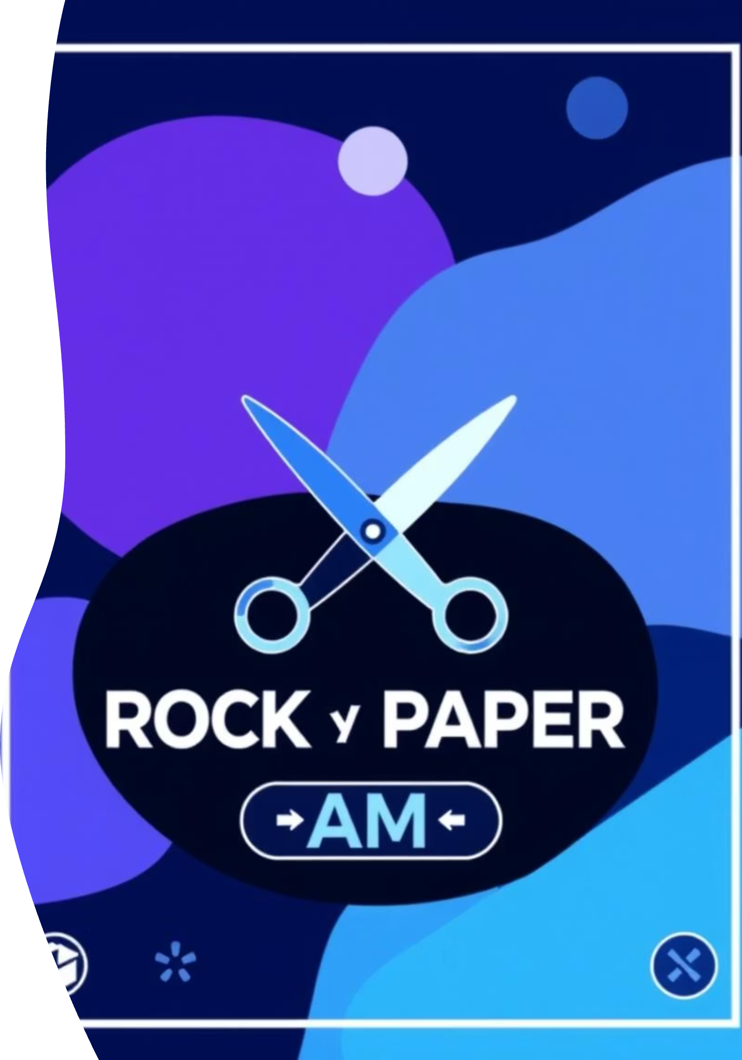
Rock Paper Scissors — Modern Python GUI
Built with ttkbootstrap • Animated • Light/Dark Mode powered by Aymen and khalil

Slide 2
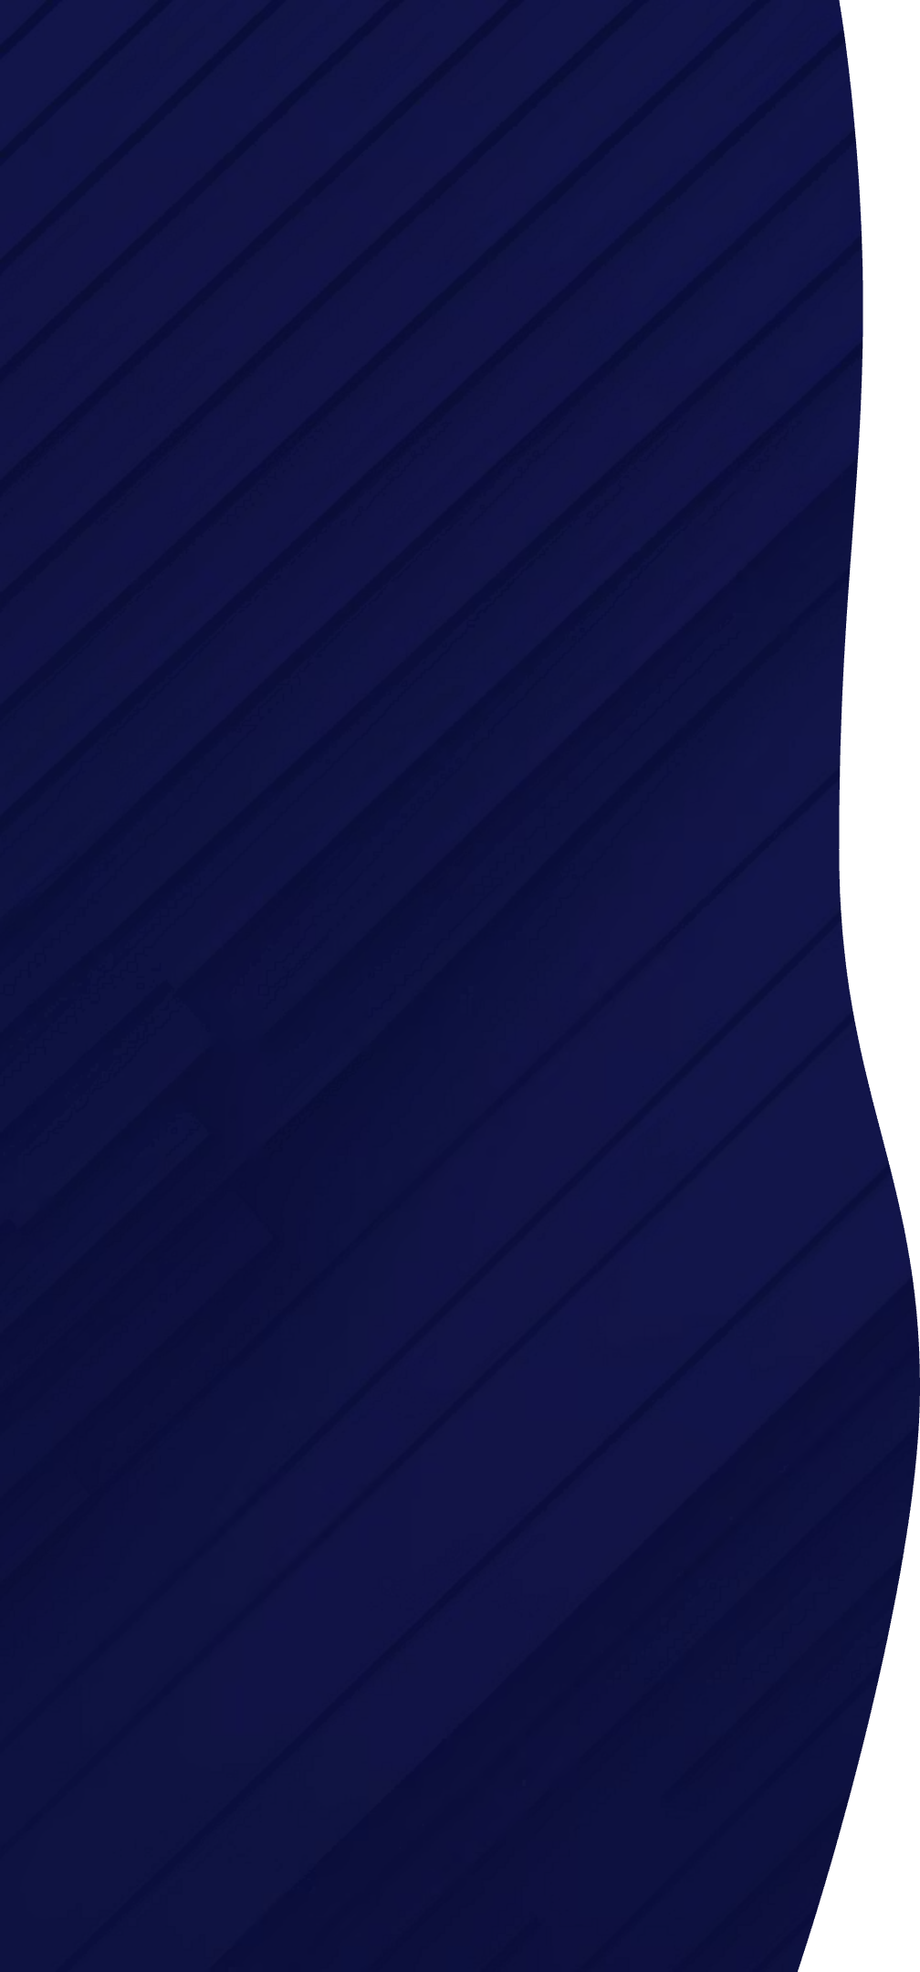





Project Overview
Rock Paper Scissors Game with Emojis
A fun and interactive take on the classic game, enhanced with vibrant emojis for a modern feel.
Light/Dark Mode Toggle
Seamlessly switch between elegant light and dark themes for optimal user experience in any environment.
Built using Python + ttkbootstrap
Leveraging the power of Python and ttkbootstrap for robust backend logic and a stunning frontend.
Goal: Learn animations, transitions, GUI styling
An educational journey to master dynamic animations, smooth transitions, and advanced GUI styling techniques.

Slide 3
Feature Overview
🎨 Modern Design
iOS-style toggle, crisp emoji buttons, and a clean layout for an intuitive experience.
🌗 Theme Toggle
Animated slide switch providing a fluid transition between light and dark themes.
🤖 Game Logic
Intelligent computer AI with a subtle "thinking" animation before making its move.
📈 Score Tracking
Real-time win/loss counter to keep track of game progress and player performance.
🎆 Visual Feedback
Dynamic background color flashes to visually indicate game outcomes (win/loss/draw).

Slide 4

Sample Code Highlight
def animate_choice(): comp_thinking_var.set("Computer is choosing...") window.after(100, show_result)class ThemeSwitch(Canvas): def toggle(self): # Slide and update theme ...
These snippets showcase the core logic behind the game's animation and the theme switching functionality. The window.after() method is crucial for scheduling GUI updates and creating the illusion of a computer "thinking" before revealing its choice. The ThemeSwitch class encapsulates the logic for the iOS-style toggle, managing the visual slide animation and updating the application's theme dynamically.
The code demonstrates effective use of ttkbootstrap widgets and Python's tkinter event loop for responsive GUI interactions. The modular design of the ThemeSwitch class promotes reusability and maintainability, ensuring a clean and efficient codebase. This approach allows for easy expansion and integration of new features in the future, maintaining the application's performance and visual appeal.

Slide 5
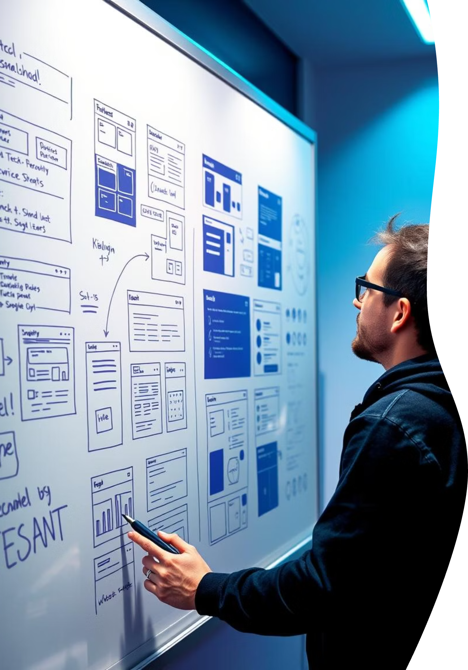
Key Learnings & Takeaways
📐 Layout Design with ttkbootstrap
Mastered creating visually appealing and responsive layouts using ttkbootstrap's powerful styling and widget capabilities.
💡 Theme Switching Logic
Implemented a robust and animated theme toggling system, allowing seamless transitions between light and dark modes.
🌀 Animation using after() method
Utilized the after() method for precise control over animations, creating smooth and engaging user experiences.
✅ Creating a Smooth and Responsive GUI
Developed a highly interactive and responsive graphical user interface that enhances user engagement and satisfaction.

Slide 6

Credits & Inspiration
Developed by: Aymen & Khalil, a collaborative effort combining expertise in Python programming and GUI design.
Tools Used: Python for core logic and ttkbootstrap for a modern and highly customizable user interface.
Inspired by: The sleek and intuitive design principles of Apple iOS, particularly its iconic toggle switches and clean UI style.
This project stands as a testament to the power of open-source tools and the endless possibilities in modern GUI development.

Slide 7
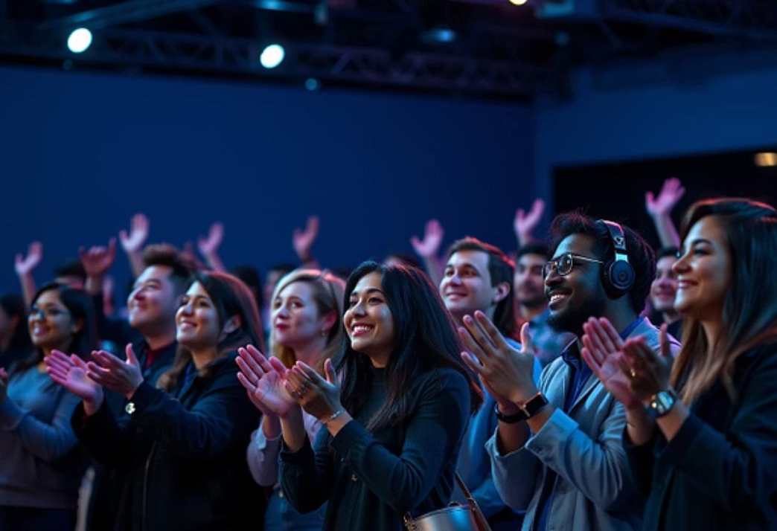

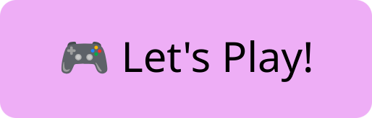
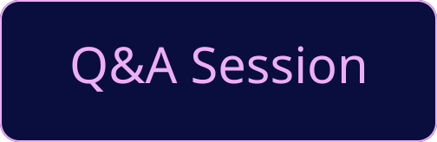
Thank You!
It's been a pleasure sharing this project with you all. I'm ready to answer any questions you might have about the development process, challenges faced, or future enhancements.
And now, for the grand finale... let's play the game demo! Get ready to choose your move!

